Slide 1
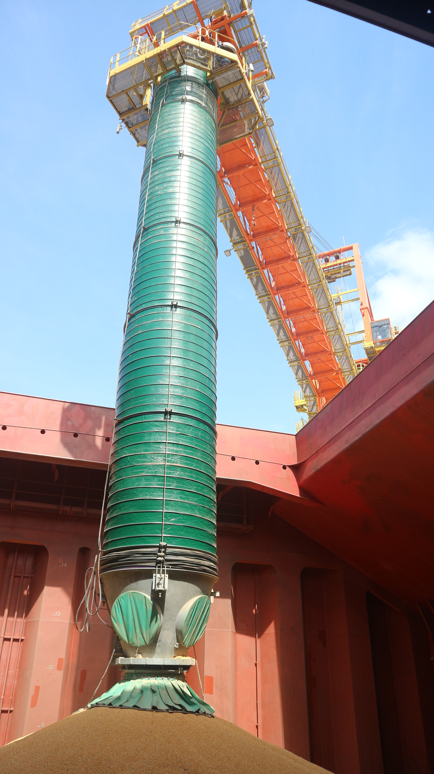
PortZone Episode 19 – Bulk Loading: Degradation & Dust Control

Slide 2
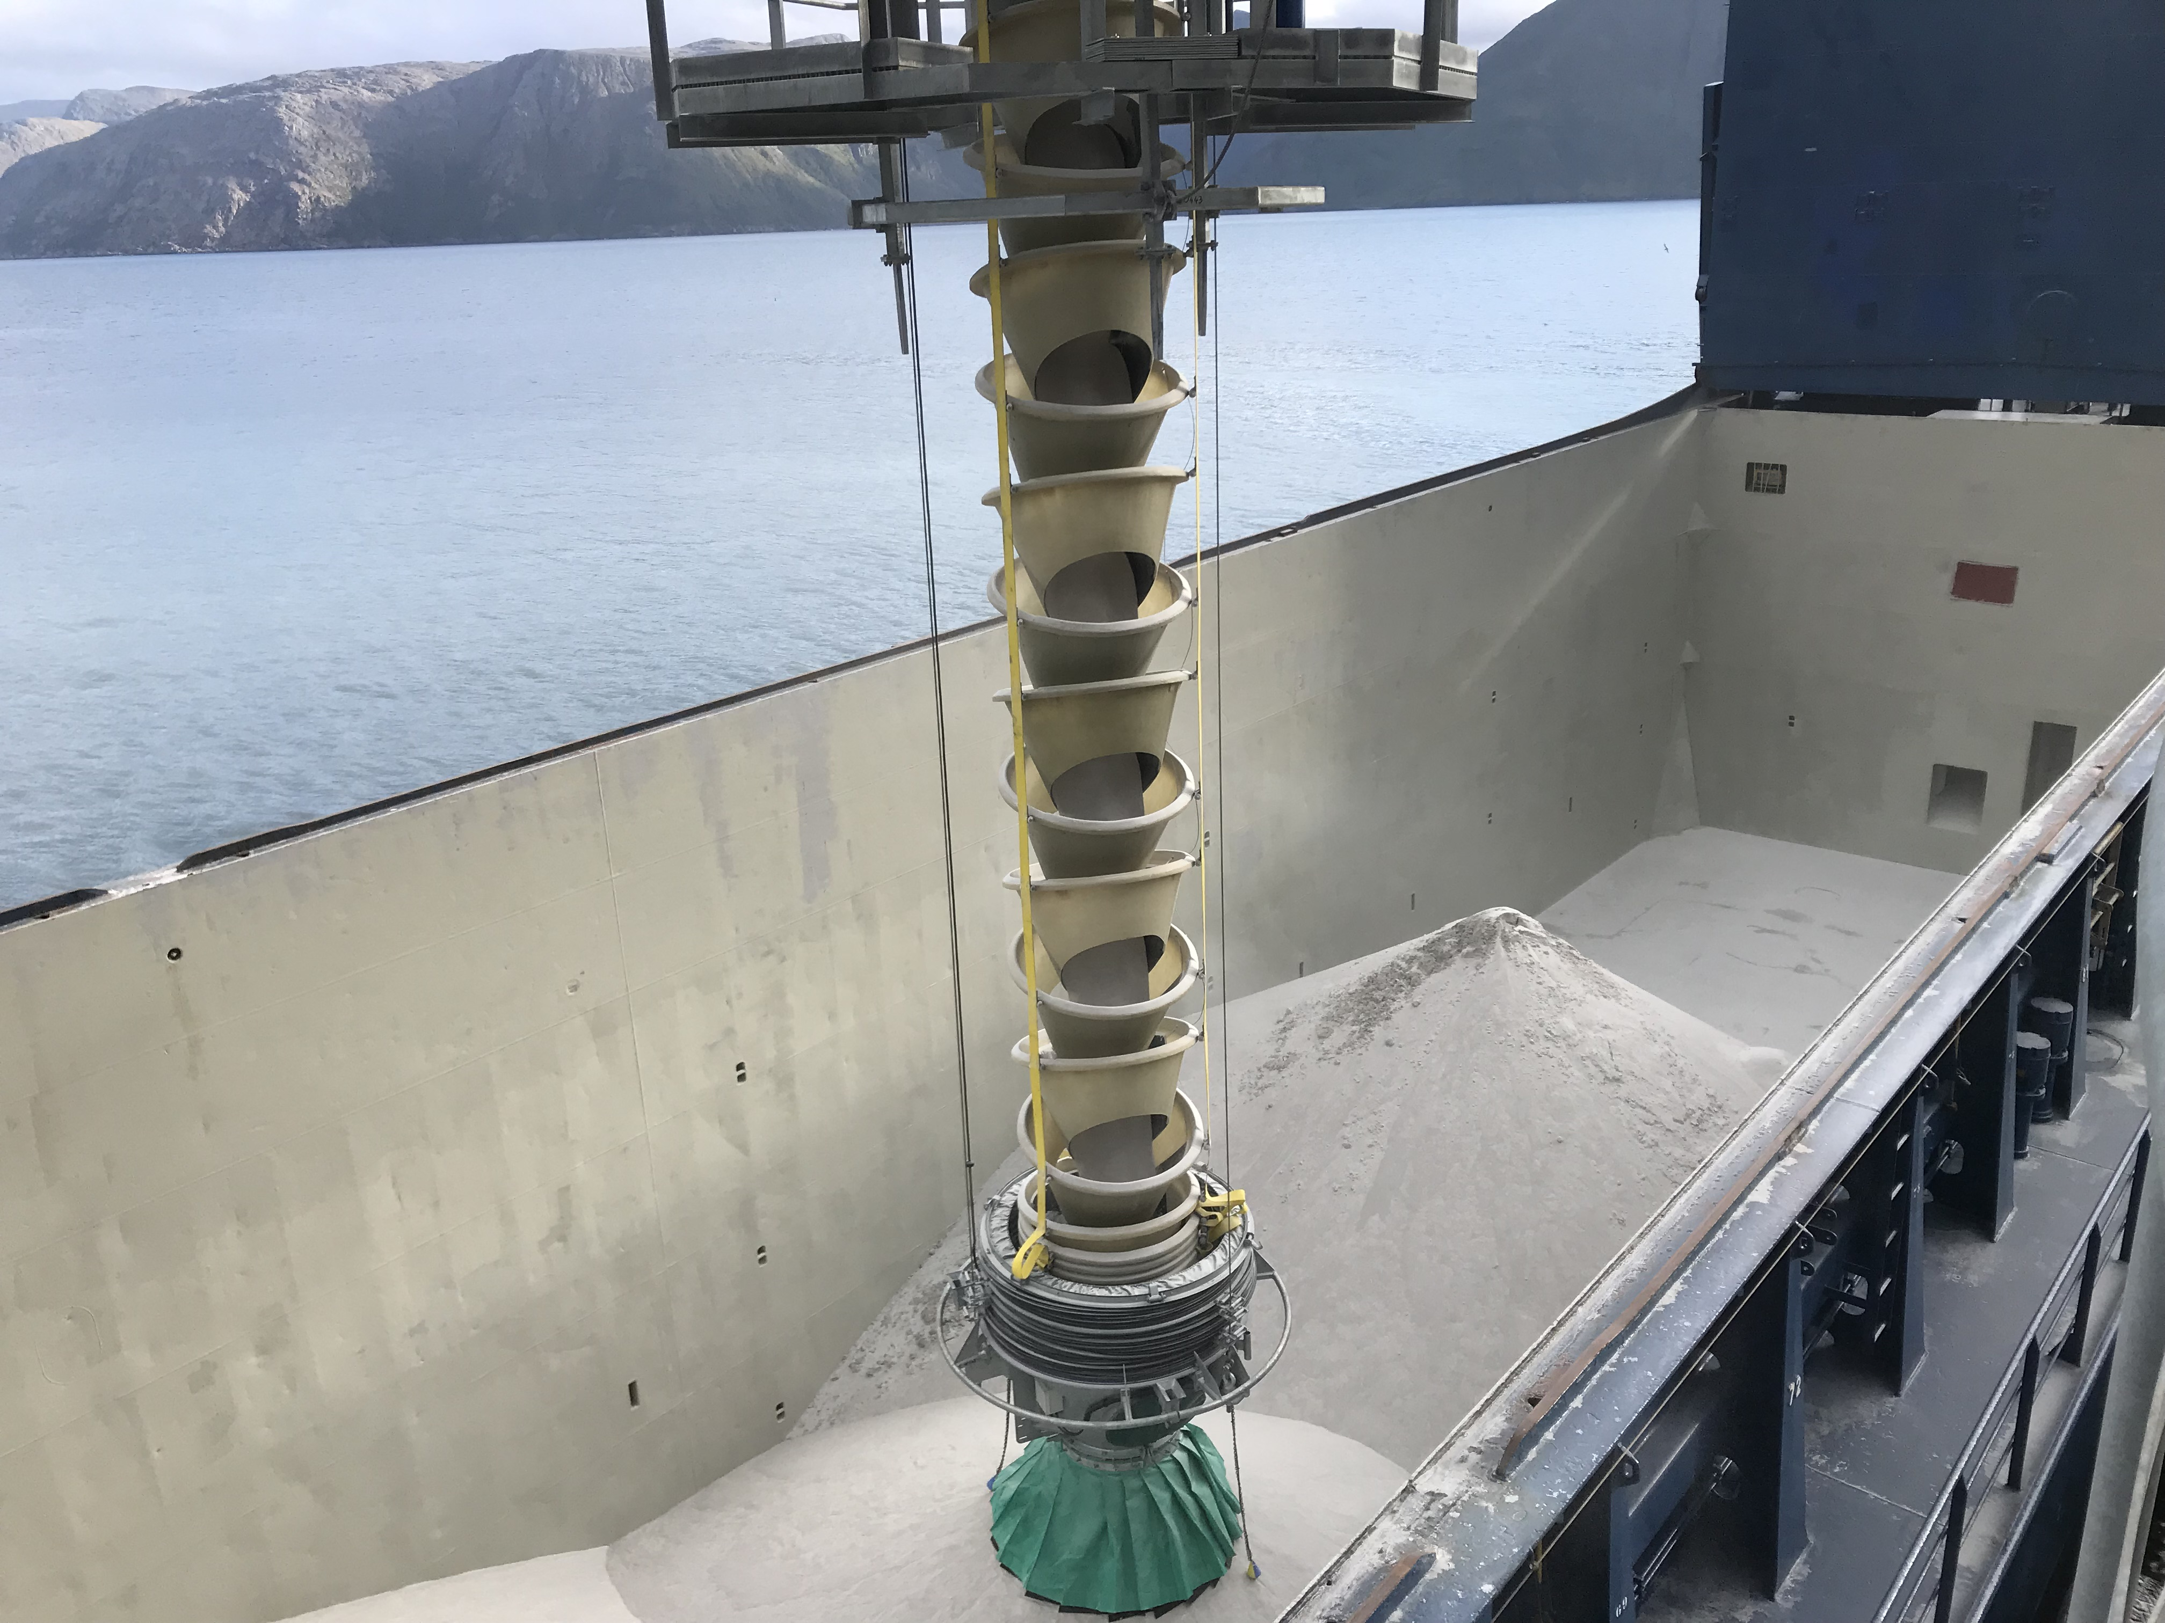
Material Degradation
One of the major challenges in bulk handling is maintaining material integrity of the product.
Degradation can reduce the bulk material process yield and the value of the product.
Degradation of bulk material also creates dust and the containment challenges that go hand in hand.
Right:
CC903 Loading Nepheline Syenite in Stjernoy, Norway at 800 Metric Tonnes per hour.

Slide 3
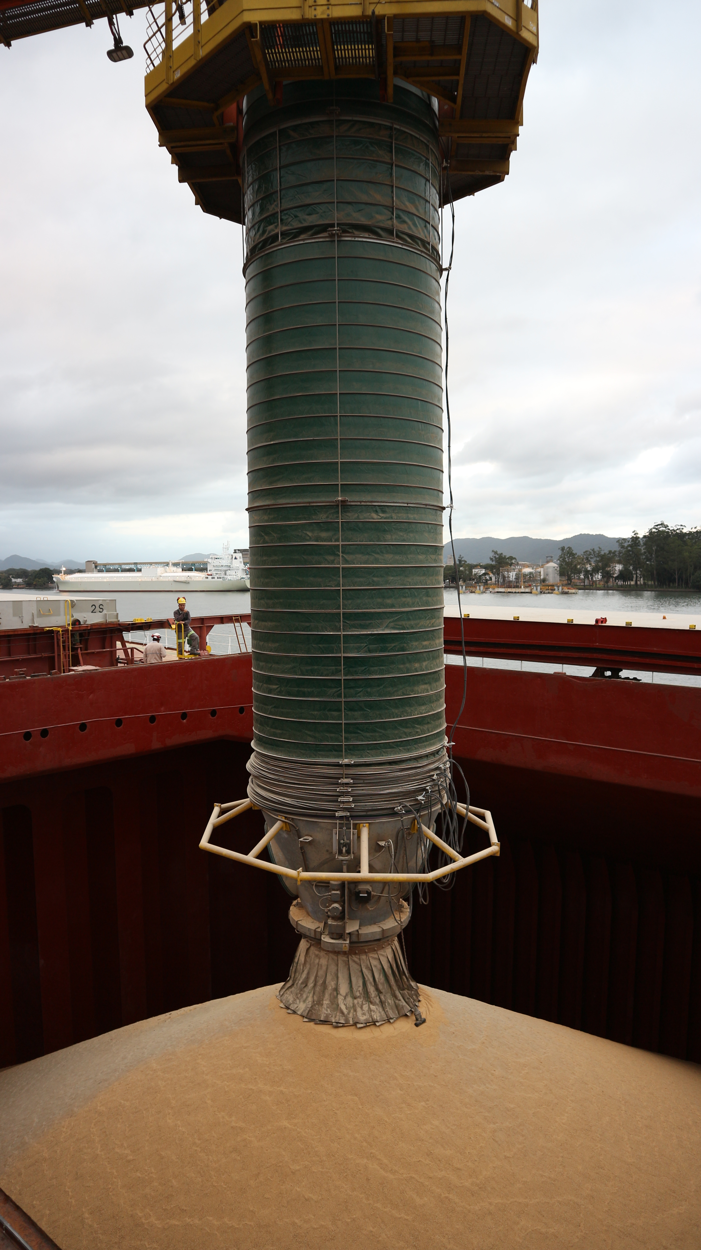
Dust Creation
Dust is a major concern for the bulk loading industry. When large quantities of materials are transferred quickly displacing air and causing particle friction large amounts of dust can be generated.
In Ports that are close to populated areas this can be a major concern causing environmental issues and can lead to respiratory problems and related health issues. It can also be a safety concern for slip hazards or even in worst cases explosions.
Right: CC862 Loading Soybeans/Soy Meal/Corn at up to 2,000 metric tonnes per hour in Santos Port, Brazil.

Slide 4
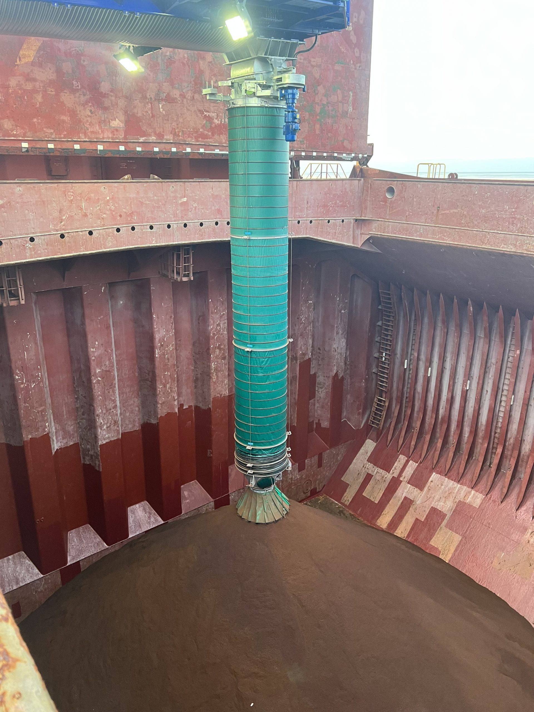
Prevention Basis
“To turn one large fall into many small falls”
The speed of the falling material is also reduced due to the lesser fall height meaning the material cannot build up the same velocity.
Any dust existing within the cascade chute is contained within the shroud cover and returned to the material flow or passed out of the carrier exit at the base.
Right: CC991 Loading Iron Ore at 750 metric tonnes per hour in Seville, Spain.

Slide 5
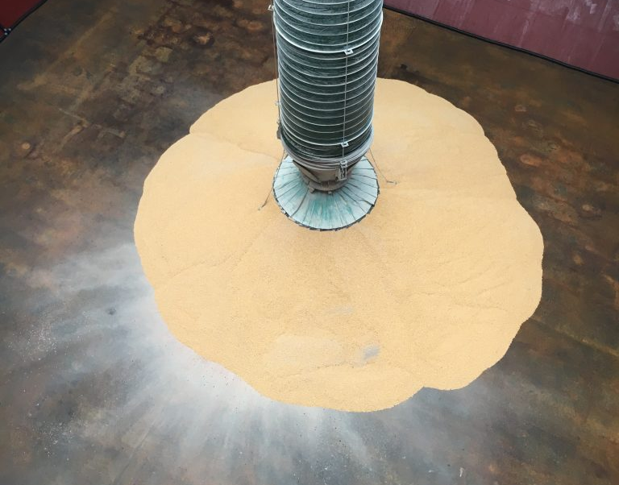
Cascade Chute – Main Features For Dust Control & Degradation
The Cascade Cones & Mass Flow
Shroud
Skirt Outlet
Auto Raise Functions
Alternate Outlets

Slide 6
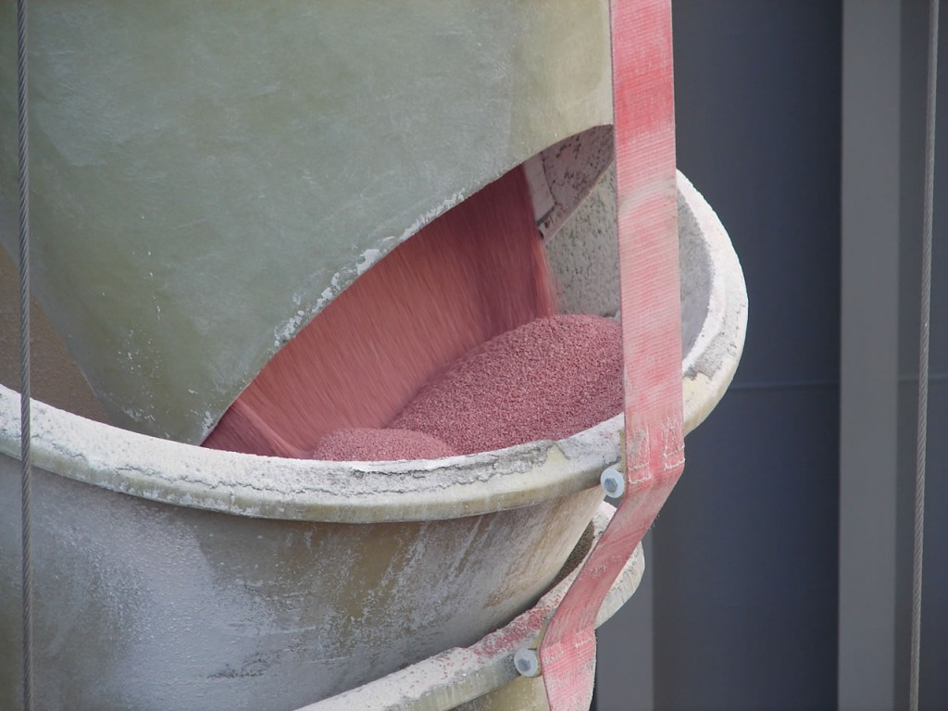
MASS FLOW
The Cascade Chute is designed to promote a state of ‘Mass Flow’.
This occurs when the material backfills the cone and then acts as resistance for the abrasion since the material is flowing upon itself.
The material can appear to be in a static state in some cases when in Mass Flow.
The cascade cones are suspended with three lengths of webbing, referred to as strops.
The system design process includes calculations for the most appropriate angles of the strops to achieve optimum loading conditions and promote Mass Flow.
Left: Mass Flow of Red Potash.

Slide 7
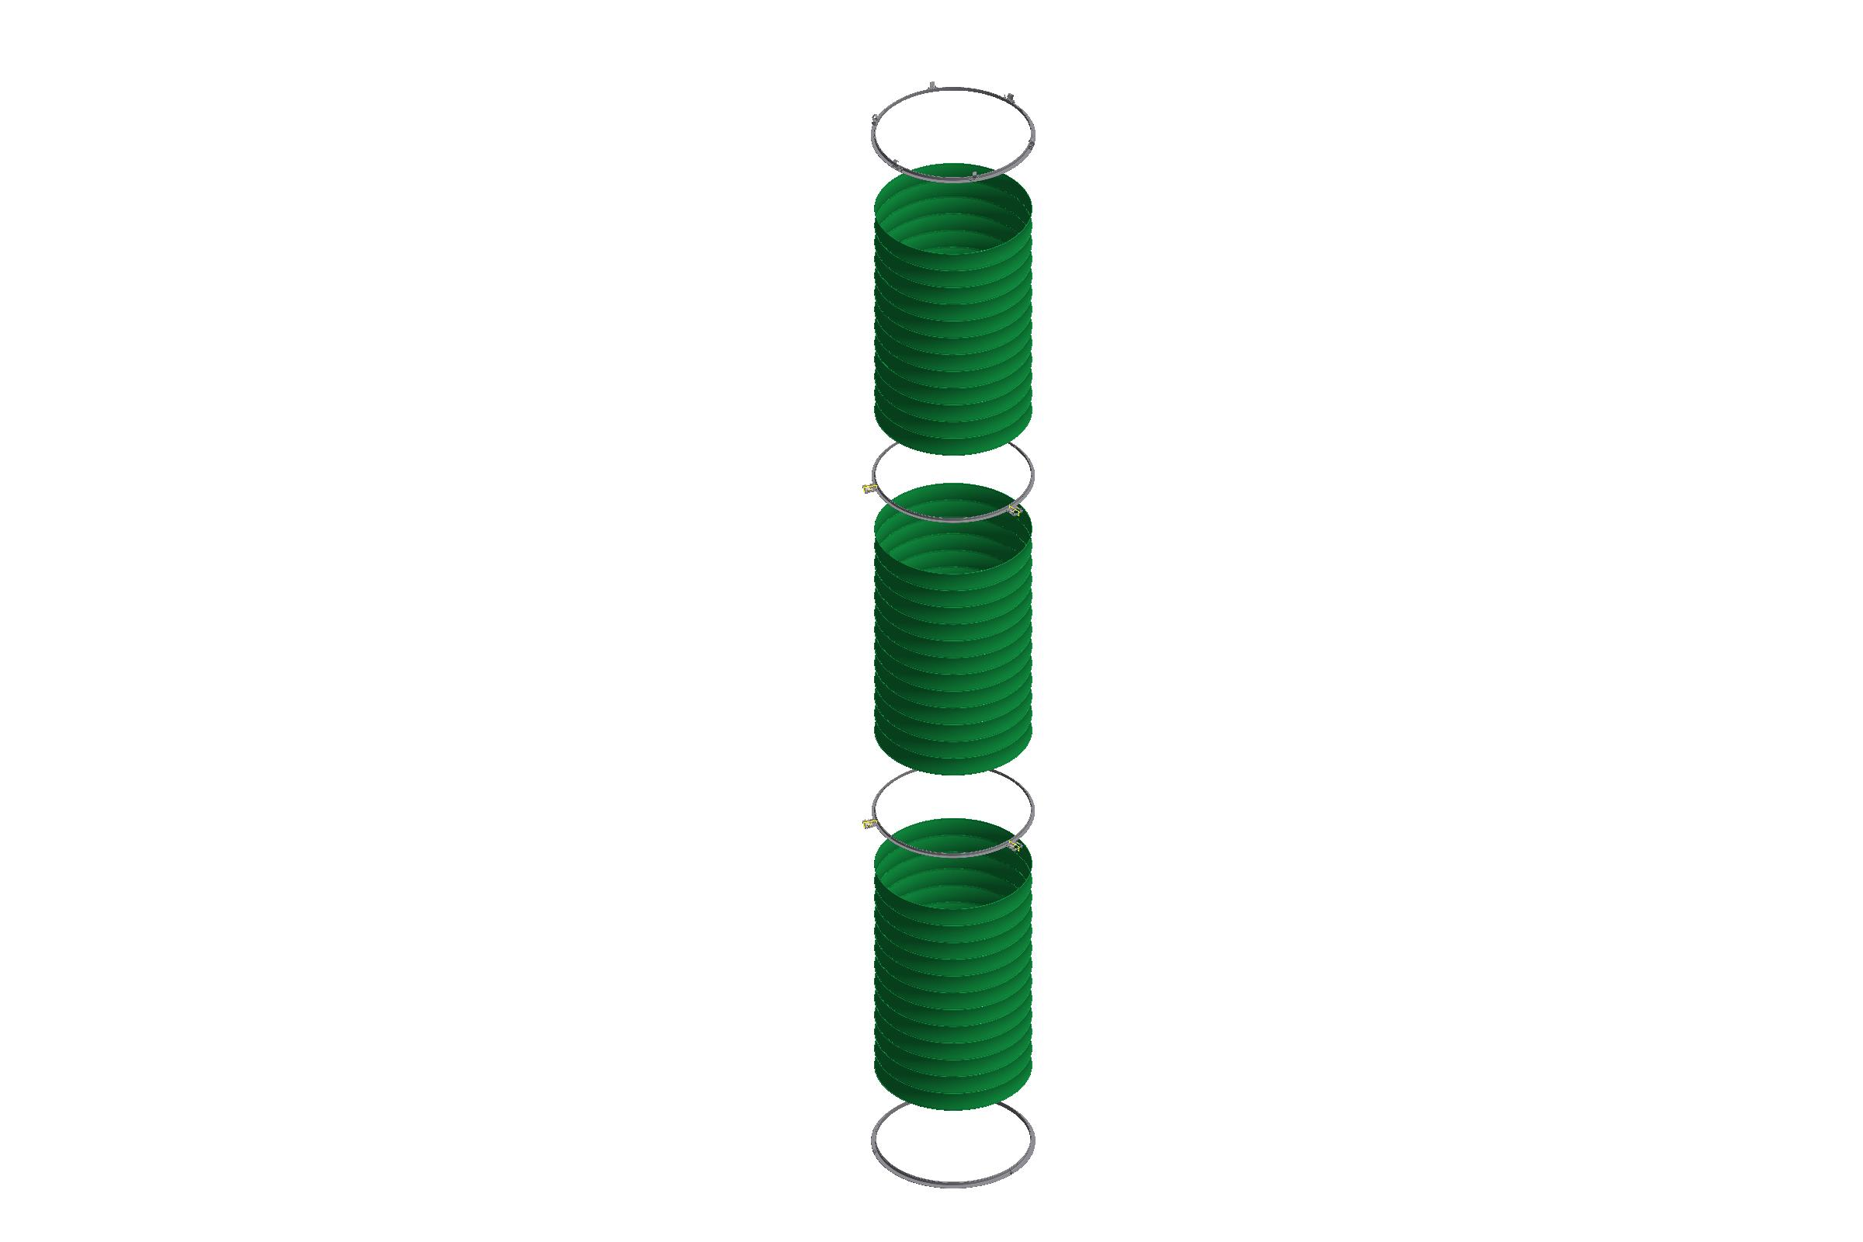
Shroud
The Shroud is a single assembly made up of a number of material sections interconnected by Steel rings.
Each of the material sections are manufactured with internal steel rings for structure. The material sections are made from PE610 or PW900 material according the application.
The sections fold and stack easily for retraction and are made to hold their own weight.
The shroud function is to provide a seal around the cones between the head chute and the carrier. It prevents any dust escaping and returns it to the material flow and removes wind from interaction with the material.
Right: Shroud Assembly example, Top ring, Top section, Intermediate Ring, Intermediate Section, Intermediate Ring, Bottom Section, Bottom Ring.

Slide 8
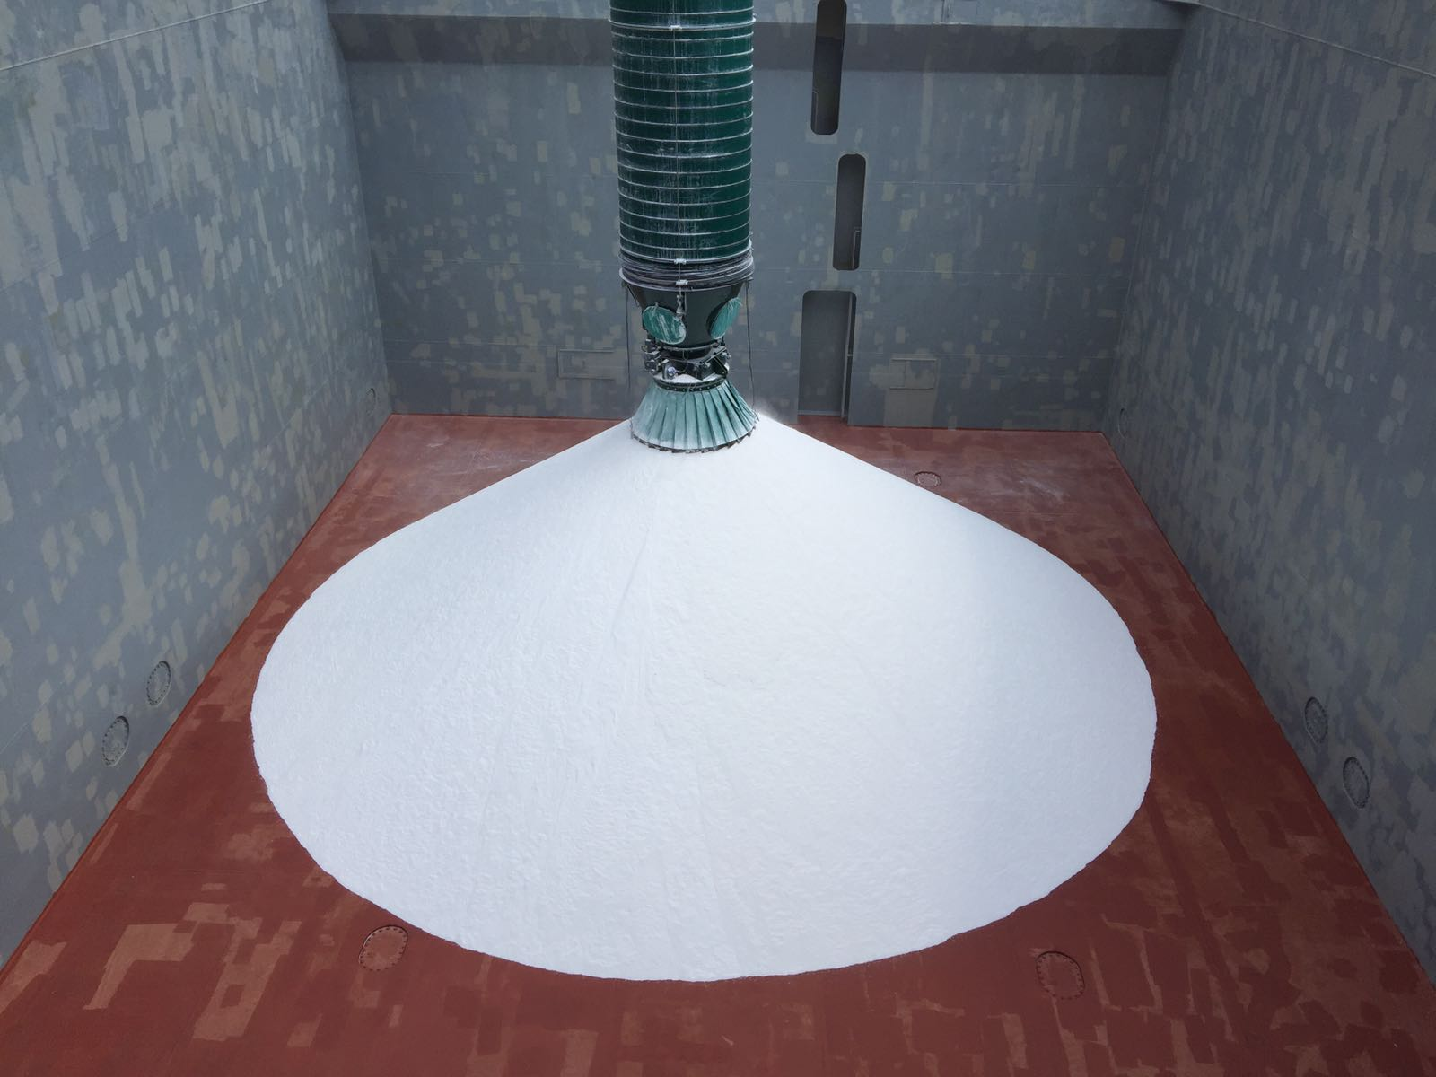
Skirt Outlet
The skirt attaches to a flange at the bottom of the carrier and is designed to aid maximum Dust Control at the point of material delivery from the Cascade.
The skirt sits over the apex of a material pile during loading to form a seal between the material and the chute.
The segmented skirt opens as the pile of material builds below the carrier. The dust seal is maintained provided that the skirts maintain contact with the material.
Left: CC729 Loading Soda Ash at 2,200 tonnes per hour

Slide 9
System Functions
There are many other features of the Cleveland Cascade System that are part of our standard supply that may not necessarily be related to the reduction of Dust and Degradation but are key elements in the loading process.
These include:
Material Detection
Automatic Raise
Downward Motion Sensing
Positional Feedback
Load Monitoring
Blockage Prevention

Slide 10
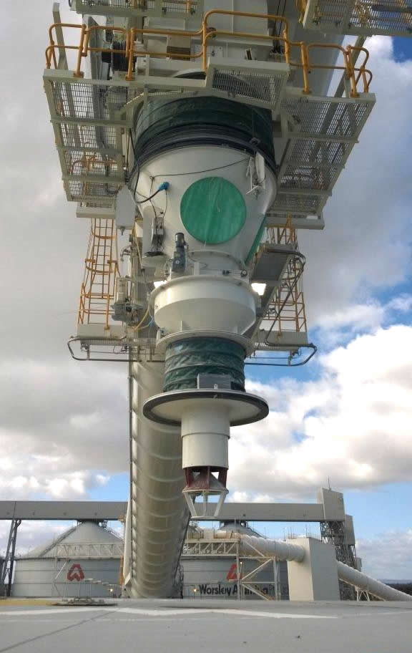
Closed Hatch Loading – Hatch Chargers
The Hatch Charger System has been developed by Cleveland Cascades, primarily for cement handlers, to overcome the problems associated with free-flowing materials which are sensitive to wet conditions.
It is designed to accommodate any movement of the vessel or water during loading and enable continuous loading of closed “cement holes”.
These are in operation for other customers with the need for continuous loading.
Right: CC420 – System loads Alumina, located in Australia.

Slide 11
Residual material spillage – Prevention
The Resitain Valve is a trap-door type valve that is installed at the base of the chute.
The valve is open during loading and closed when loading is complete.
The primary function of the Resitain Valve is to prevent residual material from falling from the chute when moving between hatches or when moving back into stowing position.
This eliminates material spillage on the deck, in the water or dock and reduces the need for post-loading clean up.

Slide 12
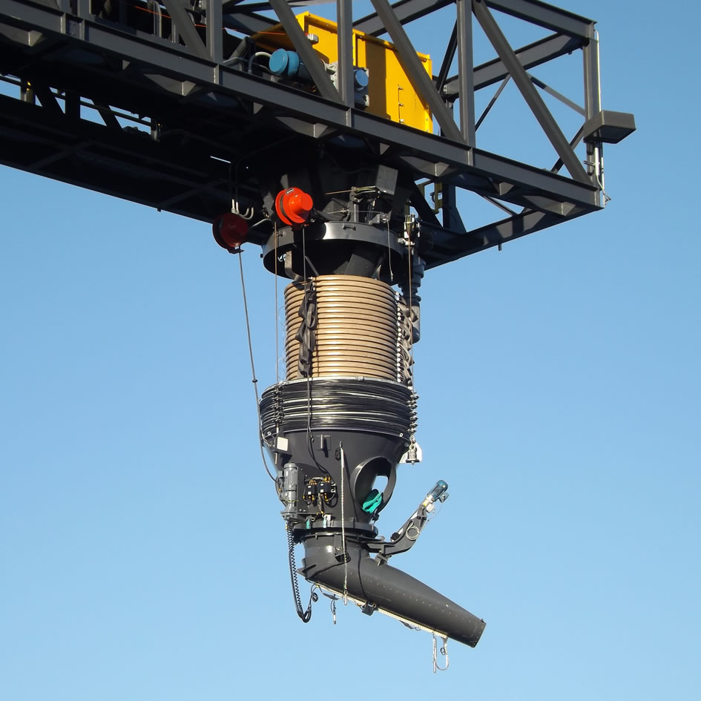
Rotating Trimming Spout
The Trimming Spout enables accurate positioning of the load within the vessel’s hold.
The Trimming Spout is mounted on a slewing ring and has an electric motor drive control.
Some systems utilise the Trimming Spouts permanently and others have them as interchangeable with the skirt outlet. The switch over can be seamless with the power cables being plug & socket and a stand for the Trimmer to be seated when not in use.
Right: Rotating trimming spout fitted to Cascade System

Slide 13
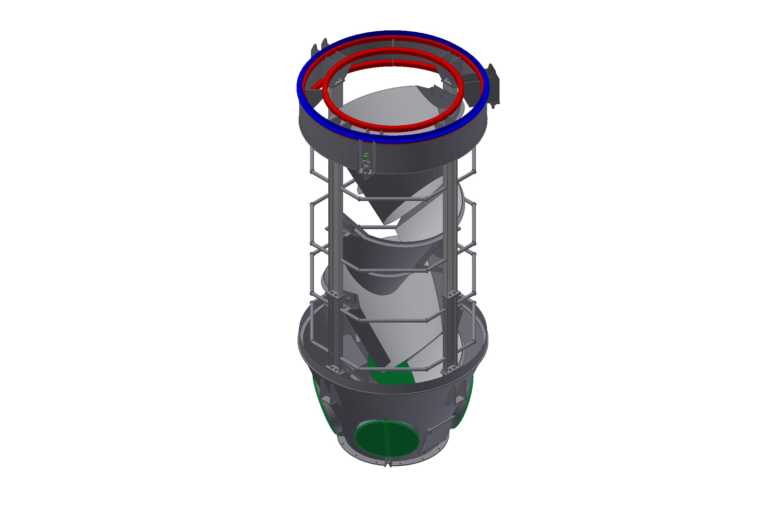
Speed Reducer
The Speed Reducer is located at the lower section of the Cascade Chute, it’s function is to control the flow velocity of the material at the outlet of the Cascade to ensure material is in Mass Flow and at low velocity. This prevents fast moving material flowing down the material pile and creating dust.
The speed reducer features 3-4 cones suspended within a rigid framework with an exit cone at the base.
The alignment of the Speed reducer is at 90 degrees to the cascade cones to allow for material collection and control.
These units are typically only supplied with very long Chutes or extremely dusty products.

Slide 14
Question – What about the inclusion of Dust Extraction systems?
We are often asked about the inclusion of dust extraction systems in our Cascade Chutes.
We have found that these are typically not needed since the Cascade System is designed to minimalize dust to such an extent that any extraction system would be negligible and would add unnecessary engineering and cost to the project.
In some cases where an end user may have insisted on the inclusion of adding a dust extraction system to the chute we would supply the head chute with a connection inlet flange for integration with a dust extraction system.

Slide 15
Case Study – Alumina Loading In India
Problem: Alumina Dust
Application to load Alumina at rates of up to 3,000 Cubic meters per hour.
Alumina is a very abrasive material and can form cutting paste if moisture is present.
Solution(s): CC923 Cleveland Cascade System
Liner Selection: Sintered Alumina Ceramic Tiles in cones and Head Chute running faces.
Strops – Dyneema Material for increased resistance to abrasion from Alumina Dust.
Right: CC923 1700 Sized Cascade System – Loading Alumina - India

Slide 16
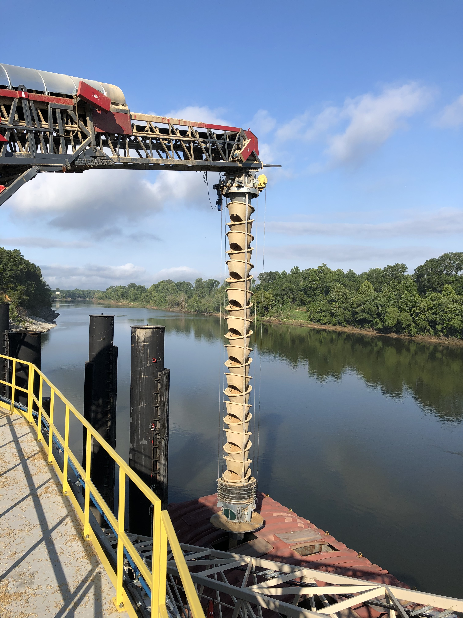
Case Study – Biomass Loading, USA
Problem: Degradation of Biomass Pellets
Solution: CC959 Cleveland Cascade System
Biomass Wood Pellets 10-12mm Dia x 10-40mm Long to be protected from Degradation and eliminate dust.
Skirt Outlet interchangeable with a loading hood for closed barge loading.
Liner Selection: Stainless Steel in Head Chute running faces, UHMWPE Anti-Static in Cones.
Additional feature(s): Anti Static System – Installed from the carrier through the cones to the head chute to earthing path for reduction of spark potential.
Right: CC959 – Barge Loading Biomass Pellets at 900 cubic meters per hour.

Slide 17
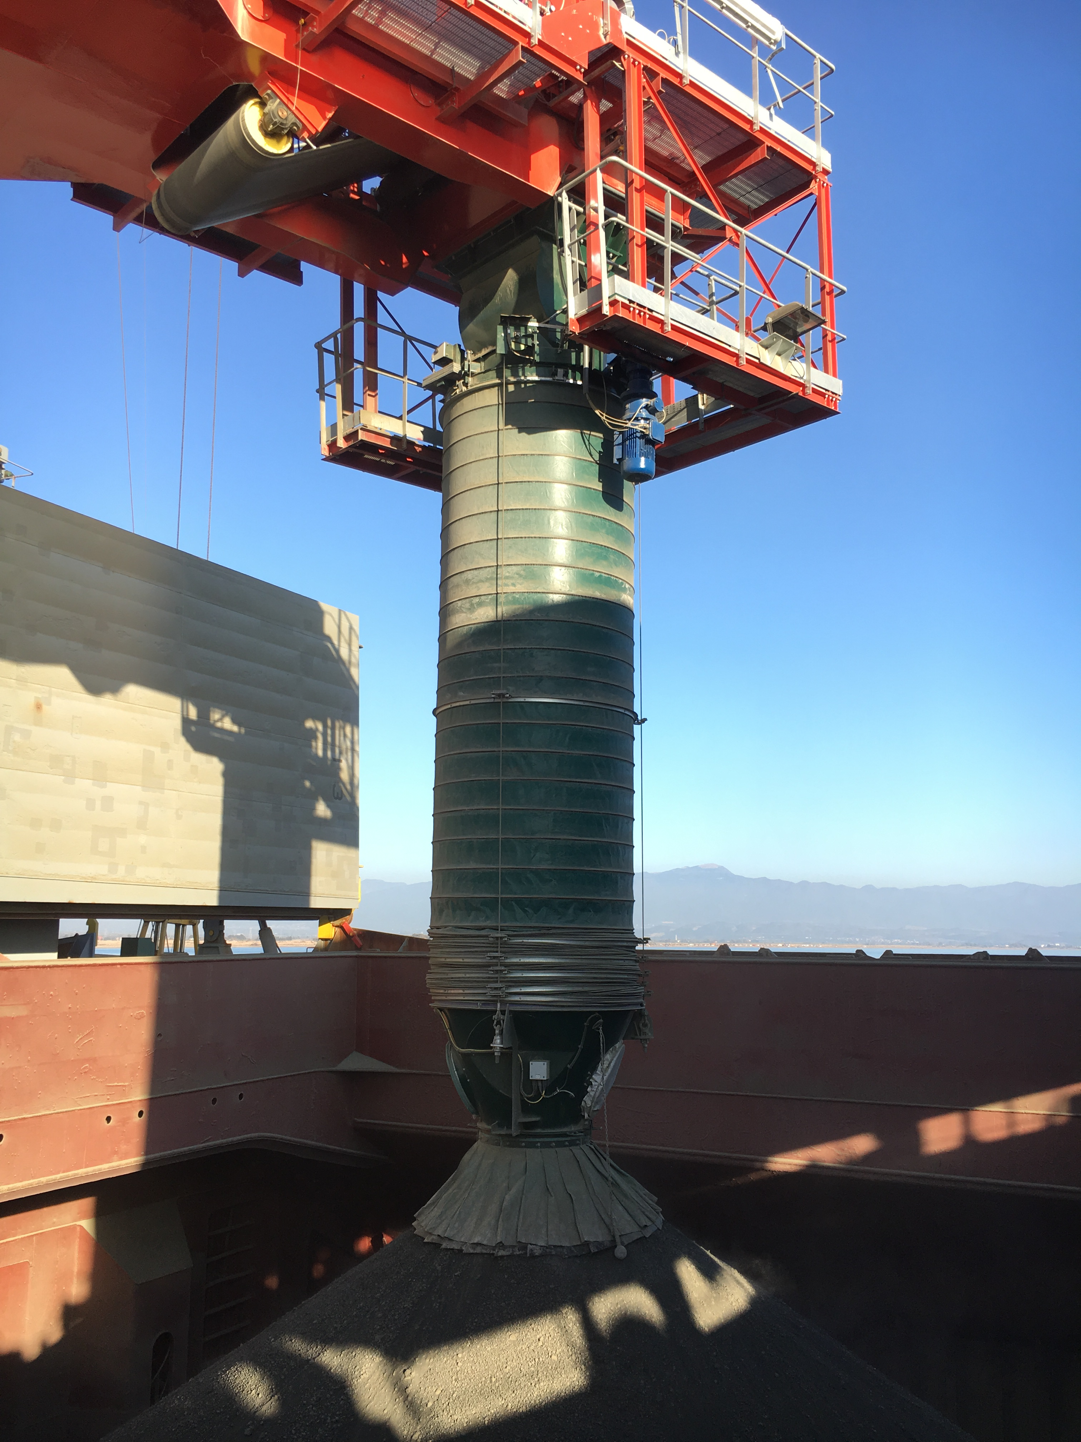
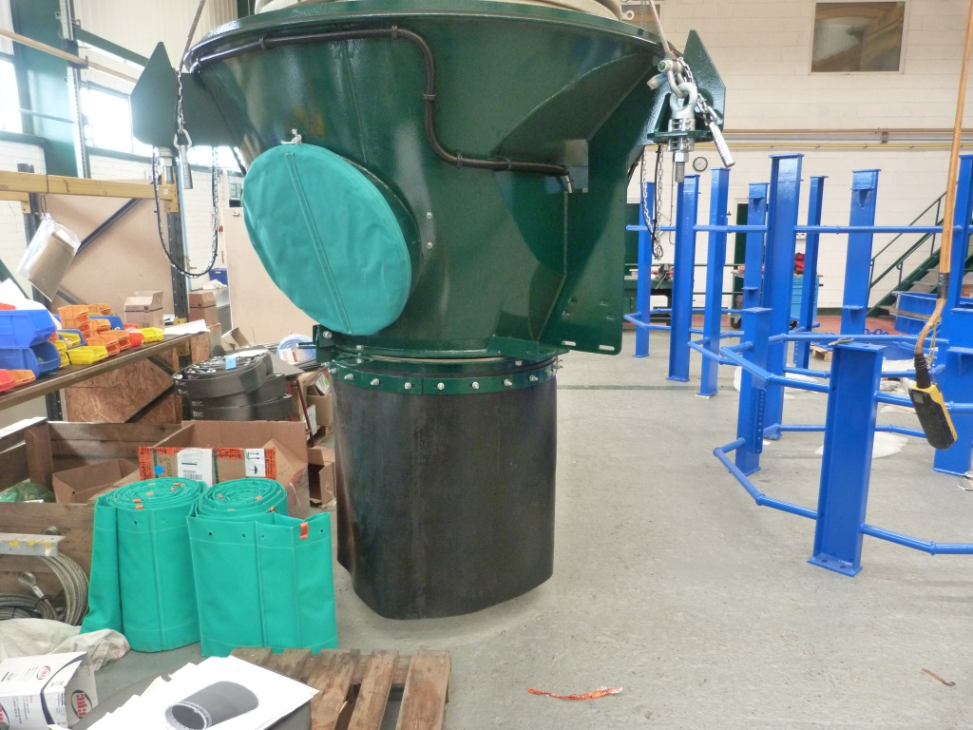
Case Study – Cement & Clinker Loading, Turkey.
Problem: Cement & Clinker Loading – Reduction of dust from loading and pile.
Solution(s): CC880 Cleveland Cascade System with added cement skirt
Liner Selection – Sintered Alumina Ceramic Tiles in Head Chute running faces and cones.
Addittional feature(s): Tubular Cement Skirt – this becomes buried in the cement material during loading creating a seal and reducing moving material down the pile further reducing dust creation.
Below : Cement Skirt
Right: CC880 Loading Clinker at 1100 tonnes per hour.

Slide 18
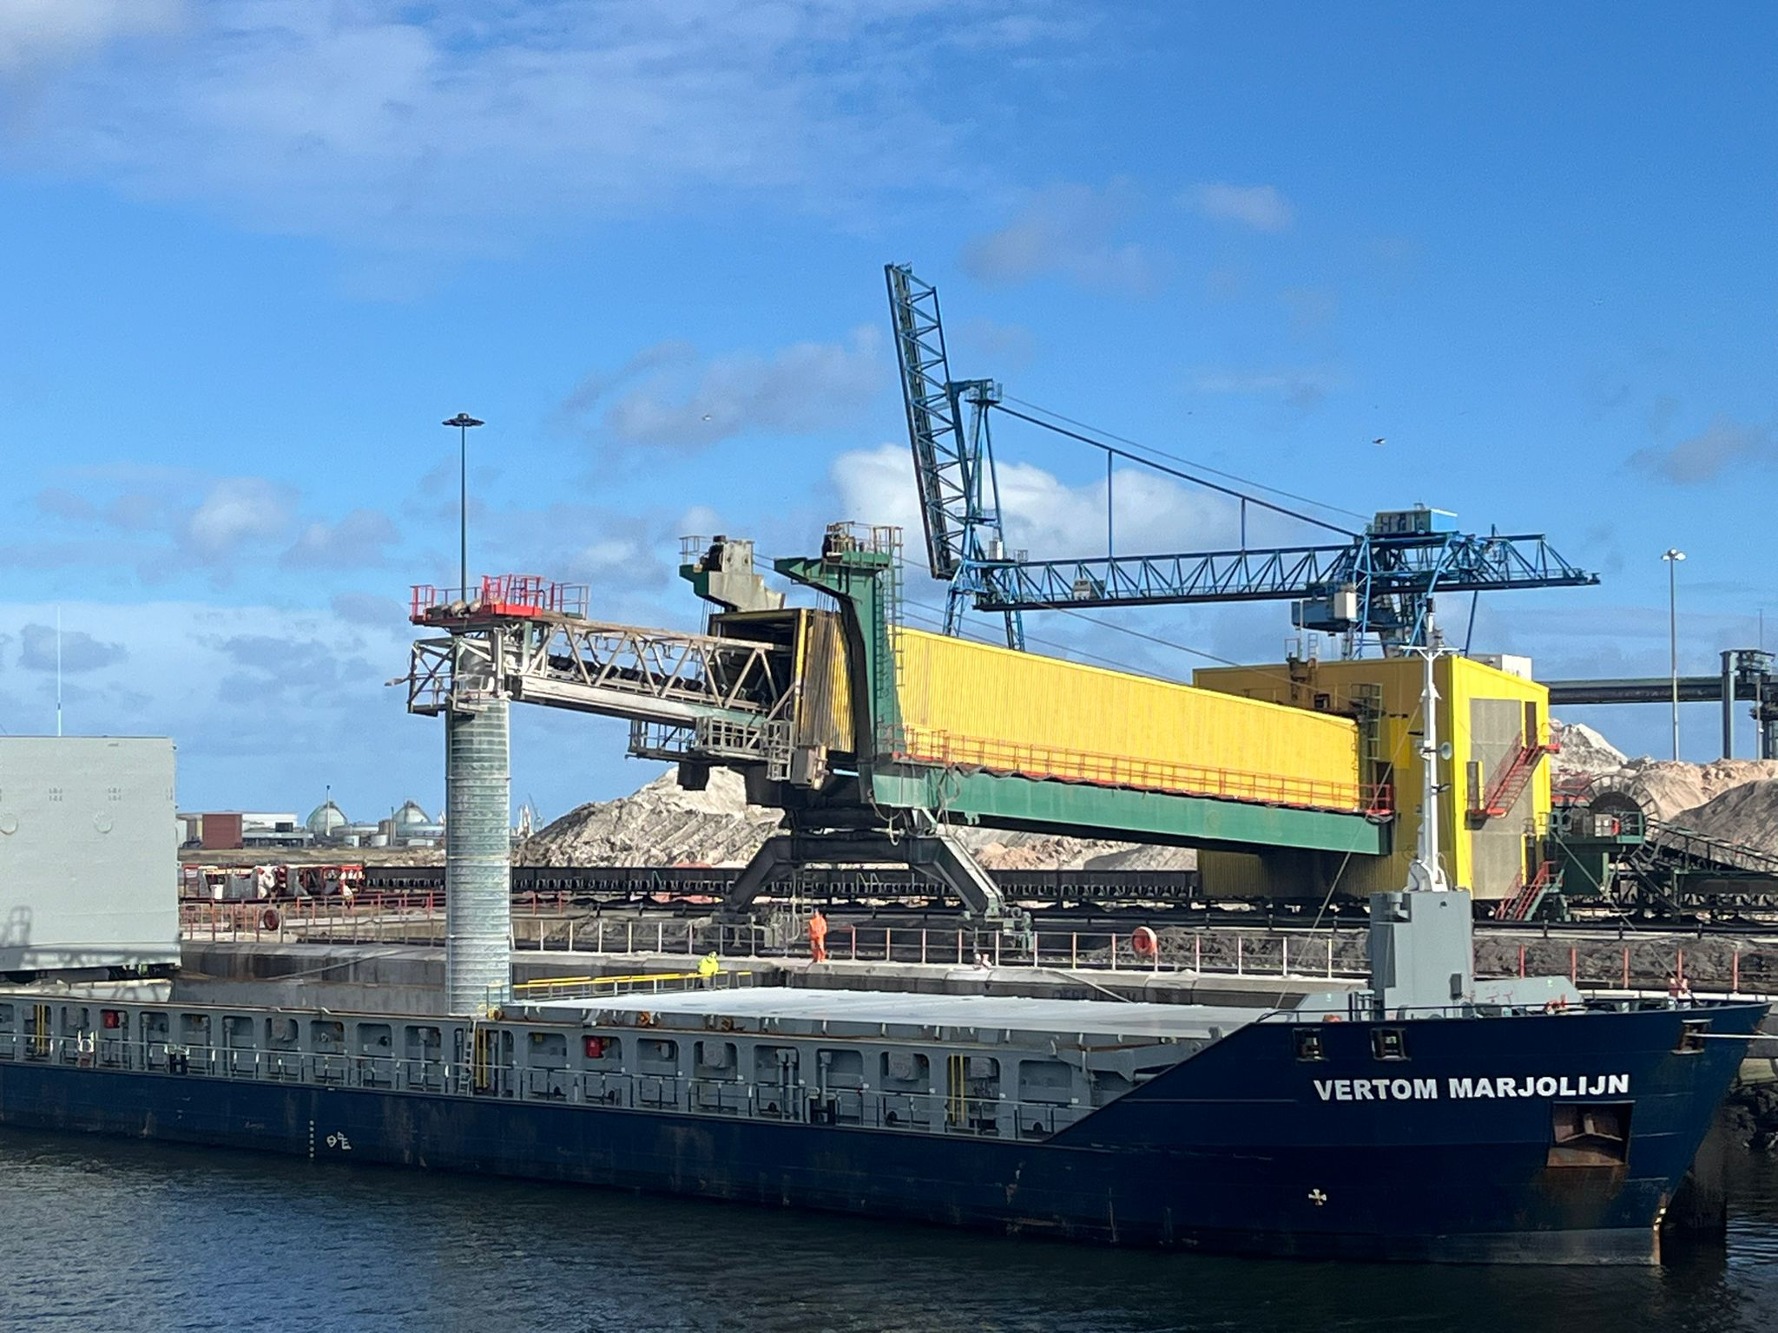
Contact Details
Website: www.clevelandcascades.co.uk
Contacts:
Shane Barnes – Commercial Manager
Tel: +441642 753275
Shane.barnes@clevelandcascades.co.uk
Stephen Beattie – Technical Sales Engineer
Tel: +441642 753277
Stephen.beattie@clevelandcascades.co.uk

